Slide 1
AGENTIC DATA RECONCILIATION
Data Observability
Agent
Telling apart "the numbers changed on purpose" from "the numbers changed because something broke."
Eli Dehaene
Notes:
Open on this line. This is the actual hard problem the whole system exists to solve, not diffing numbers, but figuring out why they moved.

Slide 2
One diff, two very different causes
INTENDED
BROKEN
A PR added a business rule, exclude cancelled orders, and the numbers moved as a direct, expected consequence.
A load half-failed, an upstream feed changed shape, or a refactor had a side effect nobody intended.
A raw reconciliation job flags both identically. Telling them apart is a reasoning task, this system spends an LLM call on only that second half.
Data Observability Agent

Slide 3
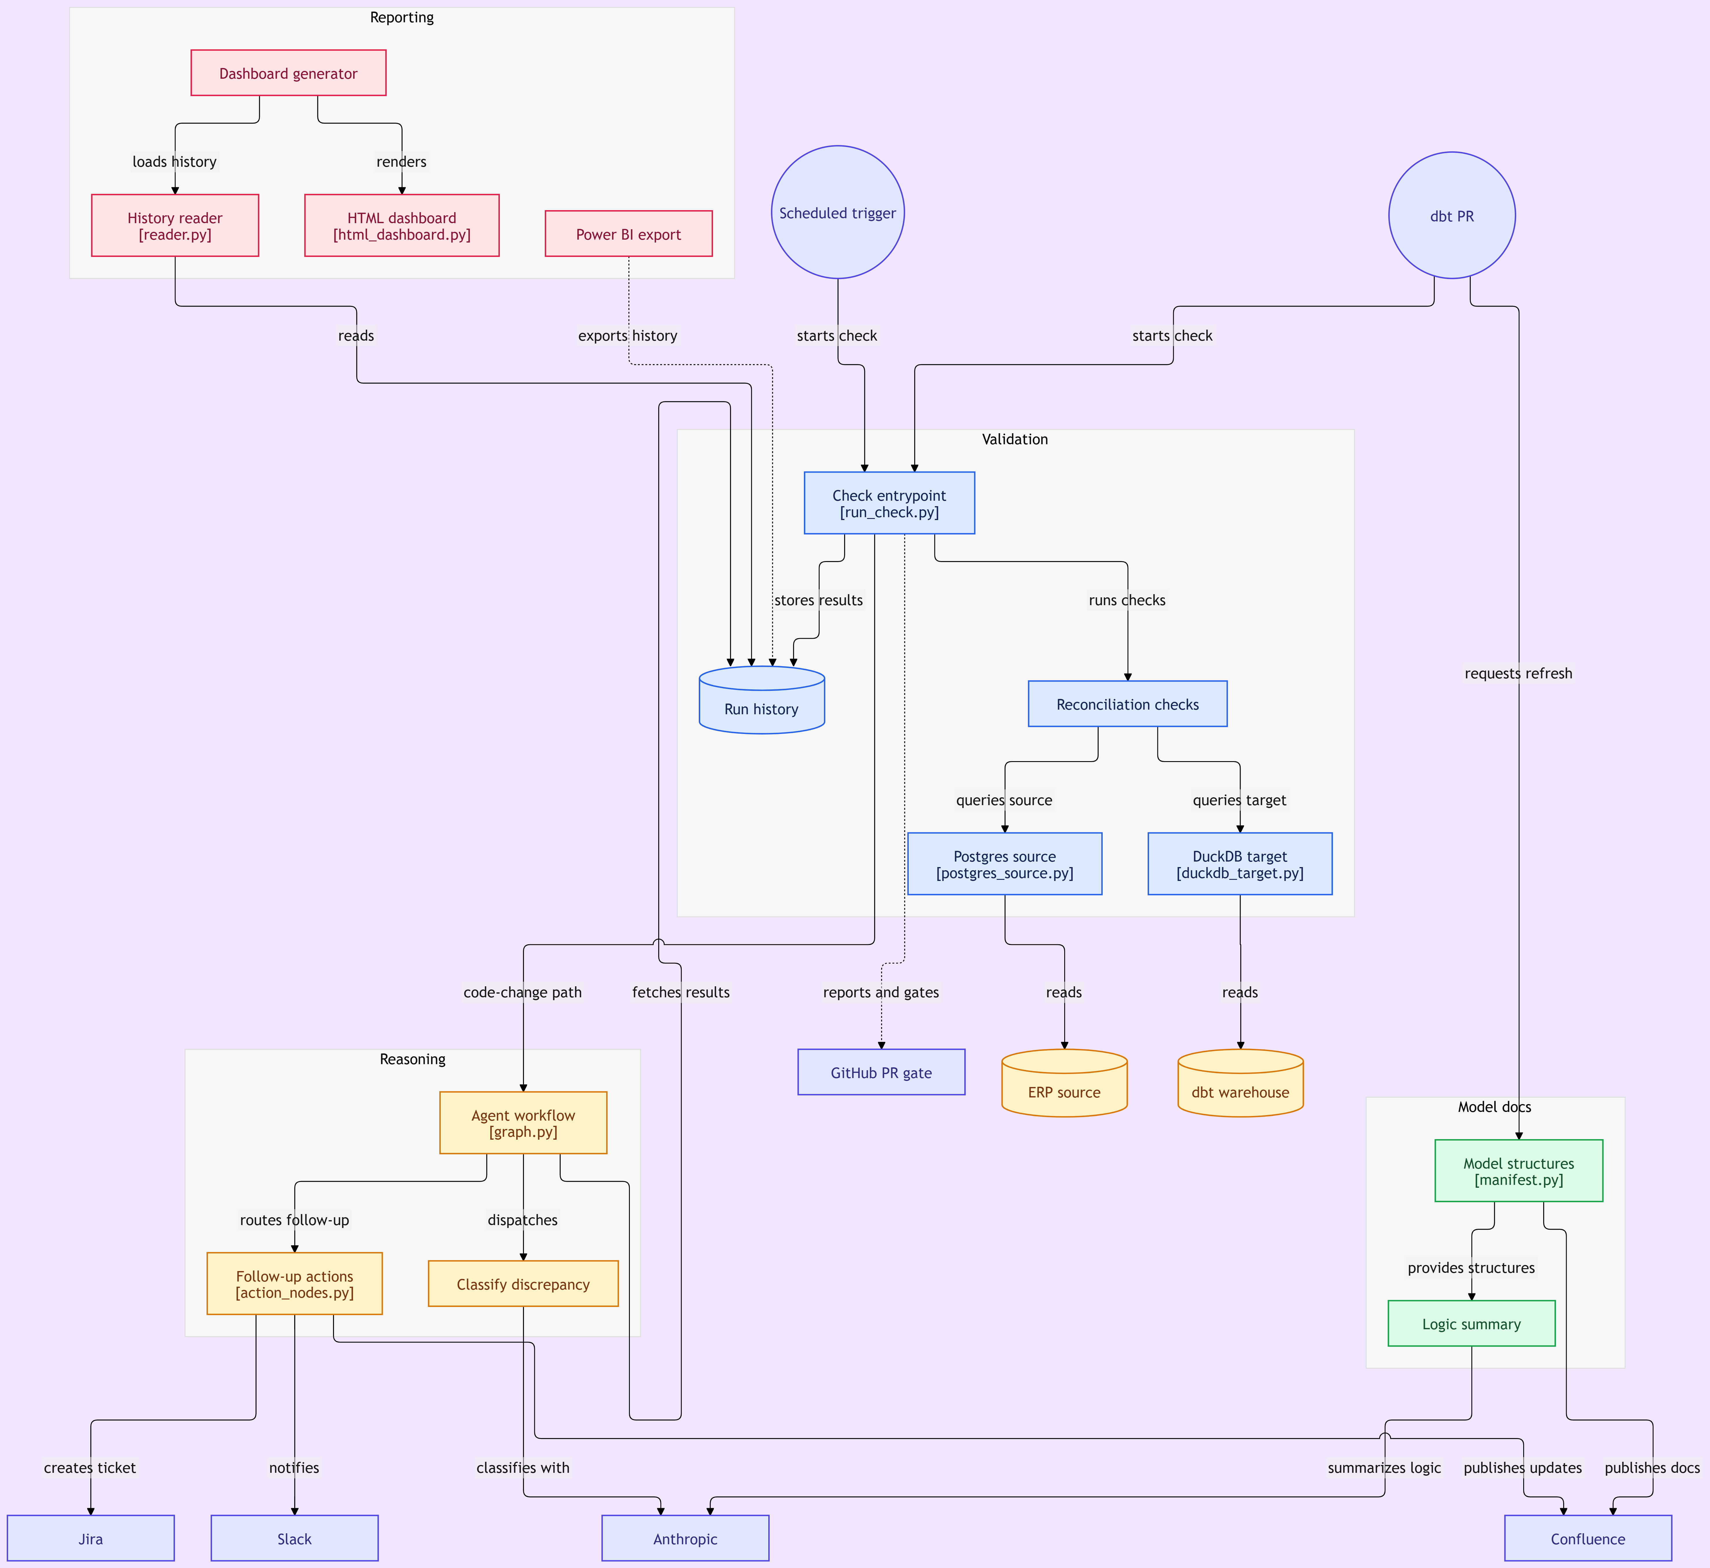
How it fits together

Slide 4
Two triggers, two jobs, never sharing a code path
 | Data-load validation | Code-change validation
Trigger | Scheduled, nightly | dbt PR / deploy
Premise | Logic unchanged, any divergence is a data problem | Logic changed, does this diff explain it?
Method | Row counts, sums, sampled comparison vs. threshold | Reconciliation plus a LangGraph agent that classifies it
LLM? | Never | Only here, forced structured output
Data Observability Agent

Slide 5
The safety net doesn't trust confidence alone
8/10
Rule 1, confidence gating. An "expected" call is only trusted above the environment's confidence threshold. Below it: downgrade to needs_review.
runs scored 0.72 to 0.75 confidence, "expected", while the model's own reasoning called the PR's claim factually wrong
Rule 2, PR-honesty override. A PR that claims "no impact" while the diff says otherwise is forced to needs_review, regardless of confidence.
Data Observability Agent

Slide 6
What's next
NOW
KNOWN LIMITATION
Live demo — a real PR, classified and routed in front of you.
The checker's "what's expected" rule list is hand-maintained today. Next: derive it automatically from the dbt models themselves.
Notes:
Land here honestly, this is the one thing I would fix next, and naming it is more credible than pretending it is finished.

